Slide 1
Python for Deep Learning
Notes:
To change color theme: go to Design Tab

Slide 2
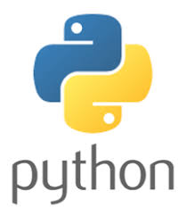
Why starting with Python?
Python is a perfect choice for beginners to make your focus on in order to jump into the field of machine learning and data science. It is a minimalistic and intuitive language with a full-featured library line (also called frameworks) which significantly reduces the time required to get your first results.
AI projects differ from traditional software projects. The differences lie in the technology stack, the skills required for an AI-based project, and the necessity of deep research. To implement your AI aspirations, you should use a programming language that is stable, flexible, and has tools available. Python offers all of this, which is why we see lots of Python AI projects today.
From development to deployment and maintenance, Python helps developers to be productive and confident about the software they are building.

Slide 3
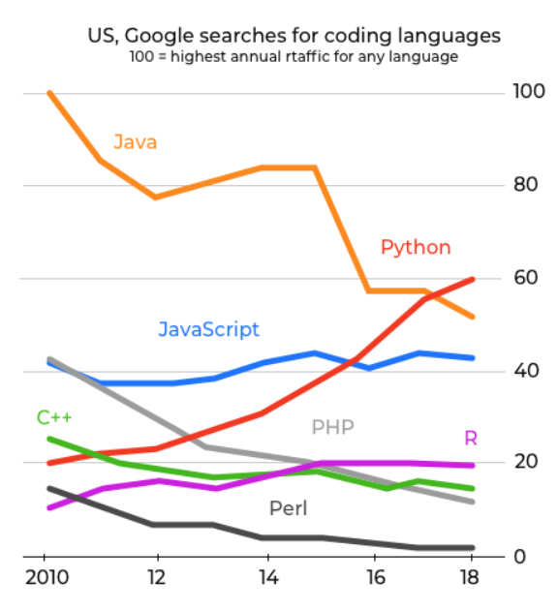
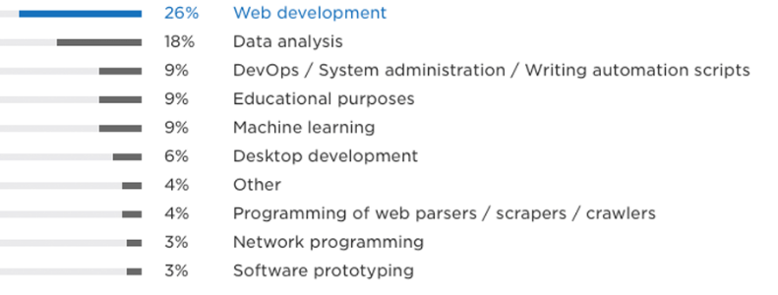
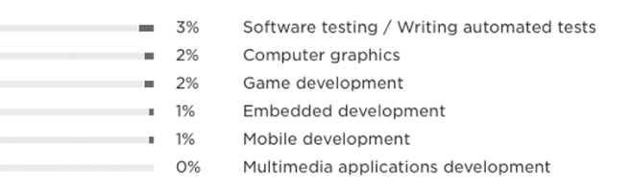
Python is:
Simple and consistent
A language with an extensive selection of libraries and frameworks
Platform independent
Has a great community and popularity
Why starting with Python?

Slide 4

The Ide Jupyter Notebook
What is Jupyter Notebook?
The Jupyter Notebook is an open-source web application that allows you to create and share documents that contain live code, equations, visualizations and narrative text. Uses include: data cleaning and transformation, numerical simulation, statistical modeling, data visualization, machine learning, and much more.
According to some users opinions:
Jupyter Notebooks are ususally in a love-and-hate relationship with users.
They are great if you see them once in a while. They are great for preparing workshops, presentations in which you show code. You can give every student a fresh, fully interactive learning environment. Sharing analysis sketches is trivial and beautiful, without any setup required by others.
However, jupyter notebooks live in their own environment, making sometimes it incredibly frustrating to reuse code or apply tools.
There is lots of hidden magic, leading to confusing and untraceable interactions with other libraries.

Slide 5

The Google Colaboratory
Project (Google Colab)
What is Jupyter Notebook?
The Jupyter Notebook is an open-source web application that allows you to create and share documents that contain live code, equations, visualizations and narrative text. Uses include: data cleaning and transformation, numerical simulation, statistical modeling, data visualization, machine learning, and much more.
According to some users opinions:
Jupyter Notebooks are ususally in a love-and-hate relationship with useres.
They are great if you see them once in a while. They are great for preparing workshops, presentations in which you show code. You can give every student a fresh, fully interactive learning environment. Sharing analysis sketches is trivial and beautiful, without any setup required by others.
However, jupyter notebooks live in their own environment, making sometimes it incredibly frustrating to reuse code or apply tools.
There is lots of hidden magic, leading to confusing and untraceable interactions with other libraries.

Slide 6
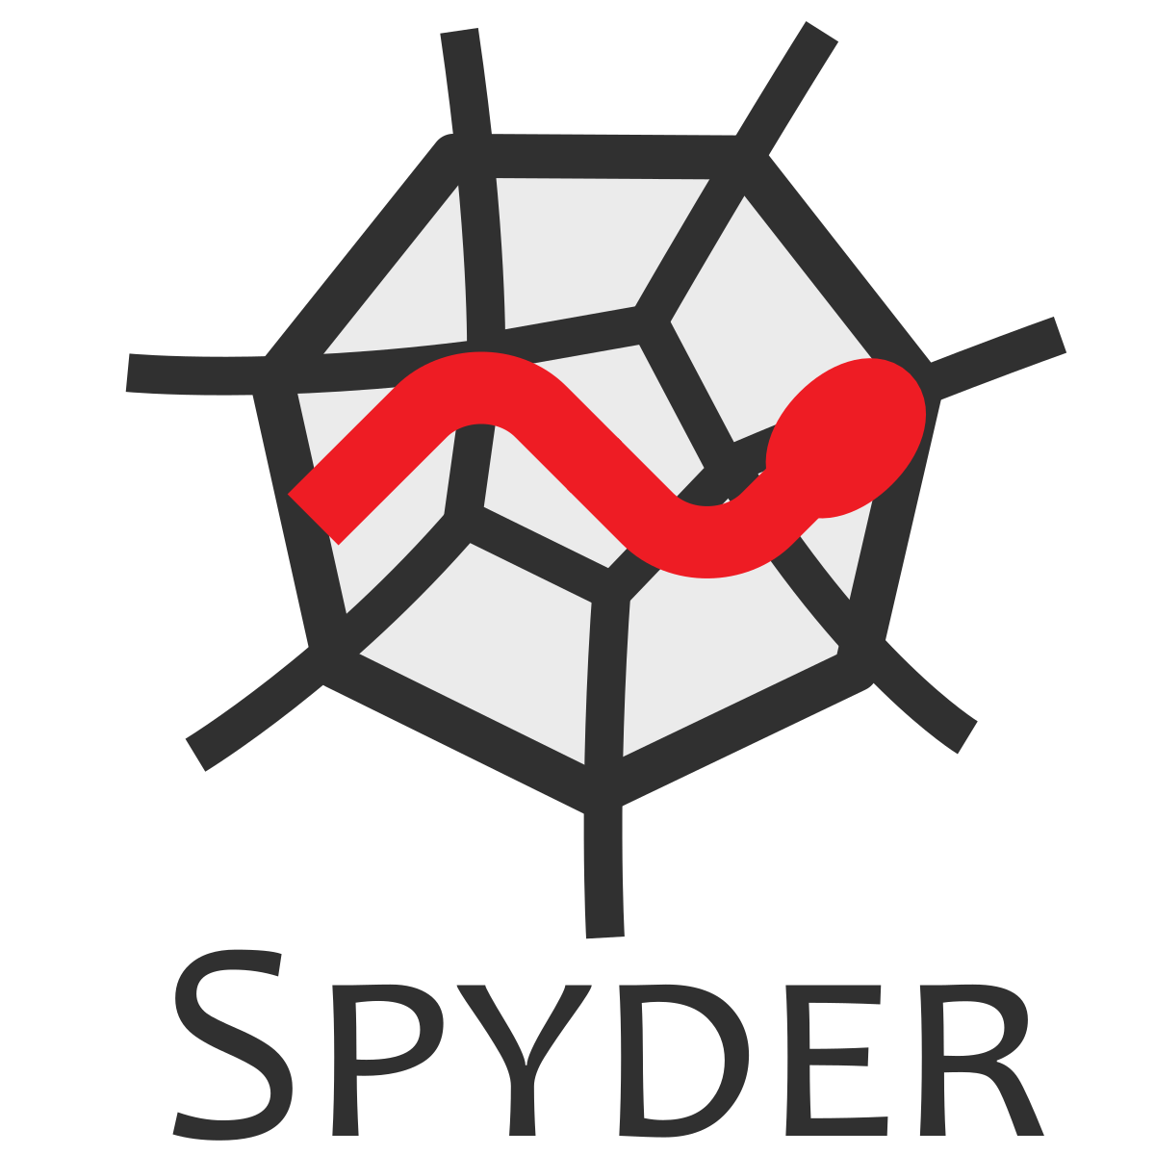
The Ide Spyder
What is Spyder?
Spyder is an open-source cross-platform Integrated Development Environment (IDE) for scientific programming in the Python Language.
Spyder integrates with a number of prominent packages in the scientific Python stack, including NumPy, SciPy, Matplotlib, Pandas, IPython, SymPy and Cython, as well as other open source software. It is released under the MIT license.
Initially created and developed by Pierre Raybaut in 2009, since 2012 Spyder has been maintained and continuously improved by a team of scientific Python developers and the community.
Spyder is extensible with first- and third-party plugins, including support for interactive tools for data inspection and embeds Python-specific code quality assurance and introspection instruments, such as Pyflakes.

Slide 7
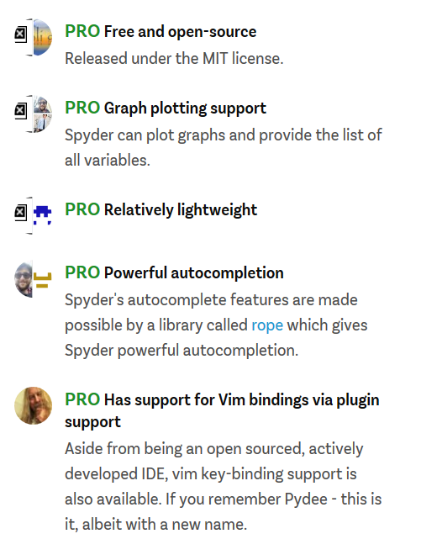
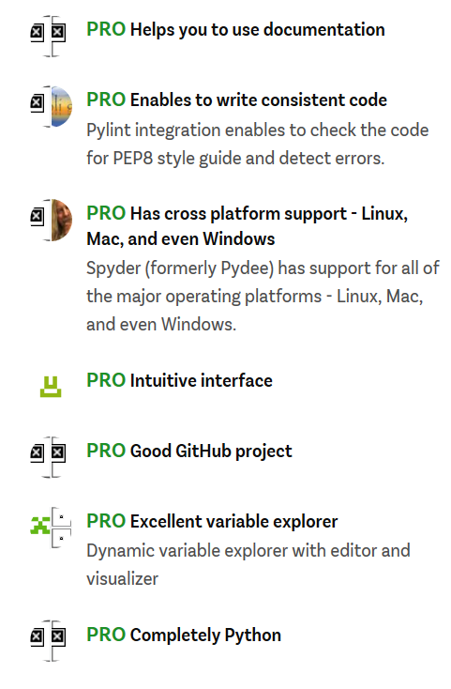
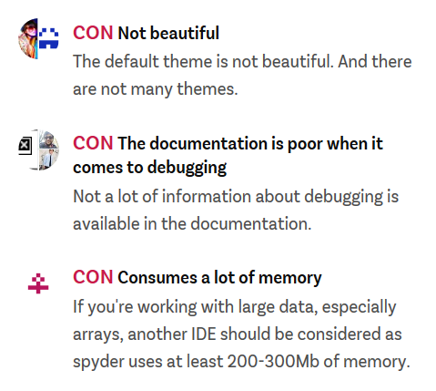
Pros and Cons
The Ide Spyder

Slide 8
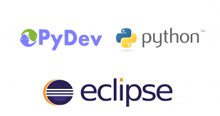
The Best Ide Ever:
Eclipse + PyDev
Why Eclipse?
Eclipse is a powerful IDE with many built in features.
Eclipse has an extensive marketplace for plugins.
It’s Open Source.
Easily sync projects to remote servers over SSH.
Nice Git integration.
What is PyDev?
PyDev is a Python IDE for Eclipse, which may be used in Python, Jython and IronPython development.
It comes with many goodies such as:
Django Integration
Code completion
Code Analysis
Refactoring
Remote Debugger
Go to Definition
Etc.

Slide 9
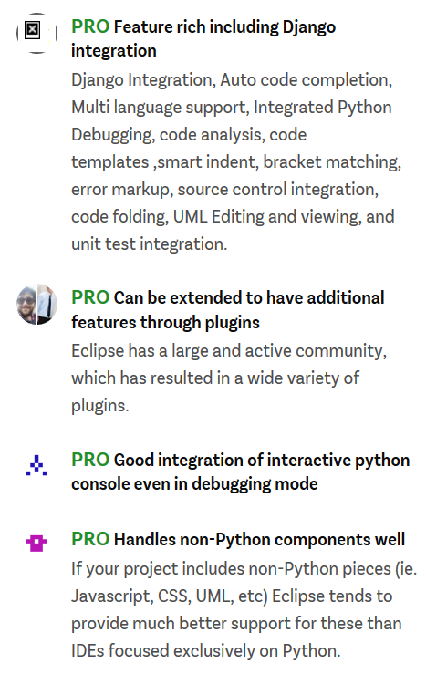
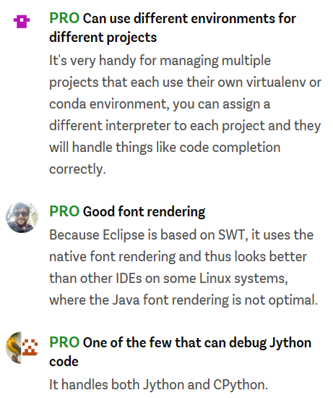
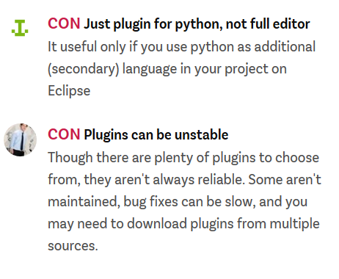

Pros and Cons
The Ide Eclipse

Slide 10
How to Install Eclipse
Download the latest version of Eclipse 64 bit from https://www.eclipse.org/downloads/
The downloaded file will look like: eclipse-inst-win64
Extract the file to a location you wish to keep the application.

Slide 11

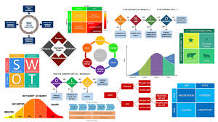
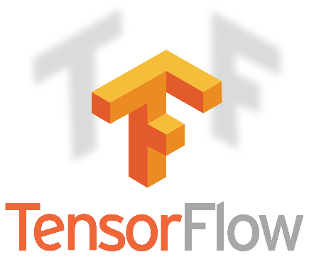

Frameworks for
Deep Learning
Keras is an higher-level interface for Theano (which works as backend). Keras displays a more intuitive set of abstractions that make it easy to configure neural networks regardless of the backend scientific computing library.
TensorFlow is an open-source software library for dataflow programming across a range of tasks. It is a symbolic math library, and also used for machine learning applications such as neural networks. It is used for both research \and production at Google.
PyTorch is an open-source machine learning library for Python, derived from Torch, used for applications such as natural language processing. It is primarily developed by Facebook’s artificial-intelligence research group, and Uber’s "Pyro" software for probabilistic programming is built on it.

Slide 12
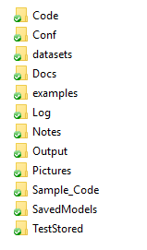
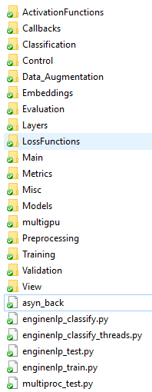
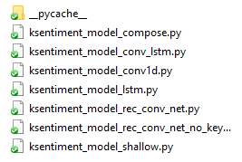

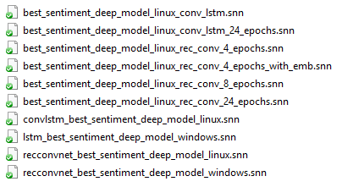
Anatomy of an advanced Python Machine Learning Application

Slide 13

Keras: The Python Deep Learning Library
Keras is an higher-level API to build neural networks Quickly. It is written in Python and works in Python.
Keras works on top of Tensorflow, CNTK or Theano accordingly. It was developed keeping in mind prototyping and fast experimentation.
Keras is able to go from the idea to the result with the least possible delay, which is the key to doing both good research and value business.
We can adopt Keras in the cases we need:
1) Enabling fast prototyping by means of friendliness, modularity and extensibility
2) Supporting both Convolutional Networks and Recurrent Networks, as well as combinations of the two.
3) Running seamlessly on CPU and GPU

Slide 14
Keras: The Python Deep Learning Library
READ THE DOCUMENTATION AT keras.io
Keras is compatible with Python 2.7 / 3.6.
The core data structure of Keras is a model, namely a way to manage layers easily. The simplest type of model can be implemented by the class Sequential, which enables to build a model as a linear stack of layers.
For more complex topologies of neural networks, implementing parallel layers for instance, we need the Keras Functional API, enabling to build arbitrary graphs of layers
Example of implementation of Sequential Model:
from keras.models import Sequential
model = Sequential()

Slide 15
Getting started: 30 seconds to Keras Library
Stacking layers is easy by the method .add of the class Sequential.
from keras.layers import Dense
model = Sequential()
model.add(Dense(units = 64, activation = ‘relu’, input_dim = 100))
model.add(Dense(units = 10, activation = ‘softmax’)
After the model definition, it is necessary to configure the learning process with the method .compile
model.compile(loss=‘categorical_crossentropy’, optimizer=‘sgd’, metrics = [‘accuracy’])

Slide 16
Getting started: 30 seconds to Keras Library
After compiling the neural model it is possible to iterate on training data in batches by using .fit method.
model.fit(x_train, y_train, epochs = 5, batch_size = 32)
Alternatively, we can train the model on each batch manually, by means of .train_on_batch.
model.train_on_batch(x_batch, y_batch)
Then we need to evaluate our model performance on a test set for example.
loss_and_metrics = model.evaluate(x_test, y_test, batch_size = 128)
NOTE: in case of evaluation or prediction the batch size can be any size, and it does not affect the accuracy of the model such as in the training stage. In test phase batch_size depends exclusively on the size of GPU. Batch_size hyperparameter so can scale up the test stage according to the computational capabilities.

Slide 17
Getting started: 30 seconds to Keras Library
At this point, we can adopt the trained model in order to predict categorical variables (classification) or continuous variables (regression). For this purpose, we need the .predict method of the class Sequential.
classes = model.predict(x_test, batch_size = 128)
This way, it is simple and fast to build a neural chatbot or a question-answer system, an image classification model, a text classifier or any other model.
The idea behind keras is that Deep Learning implementations are not painful anymore.

Slide 18
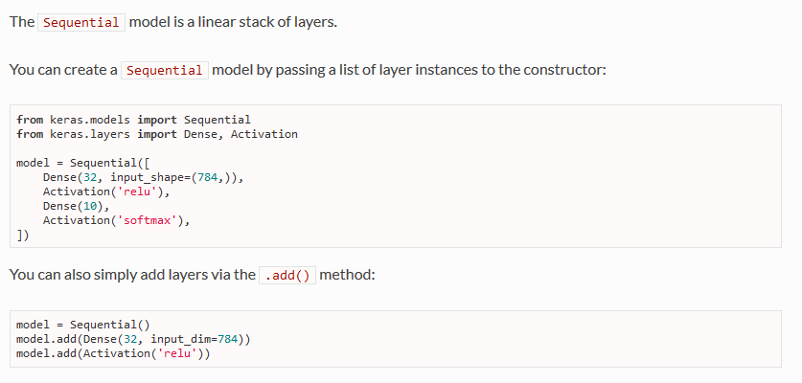
Keras Sequential Model

Slide 19
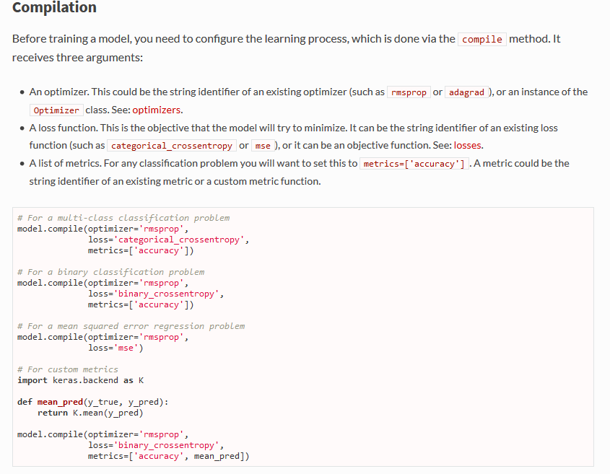
Keras Sequential Model

Slide 20
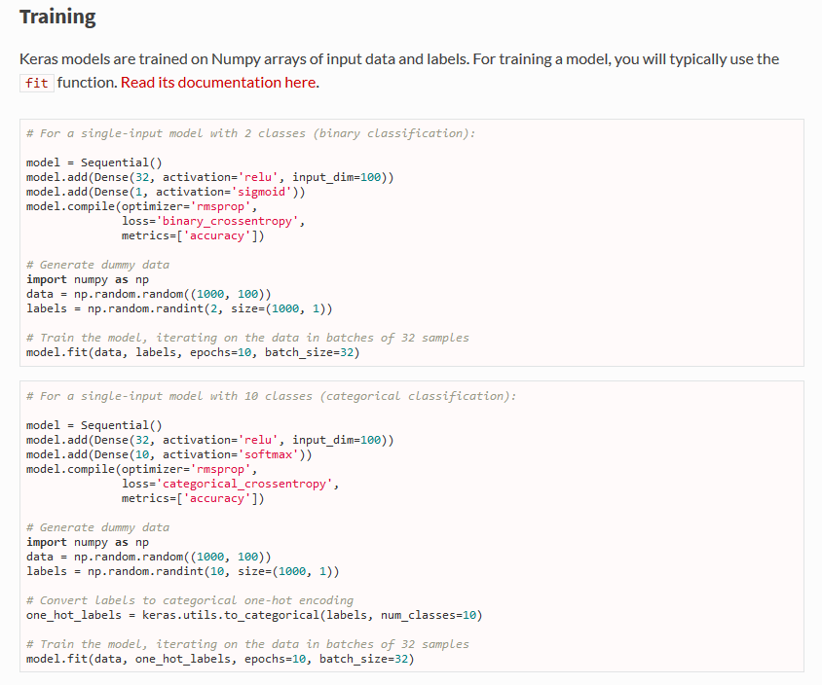
Keras Sequential Model

Slide 21
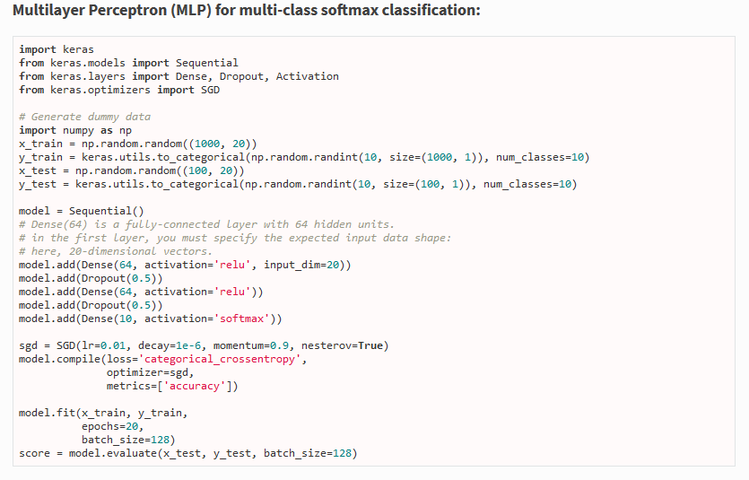
Keras Sequential Model

Slide 22
Thank You

